Slide 1
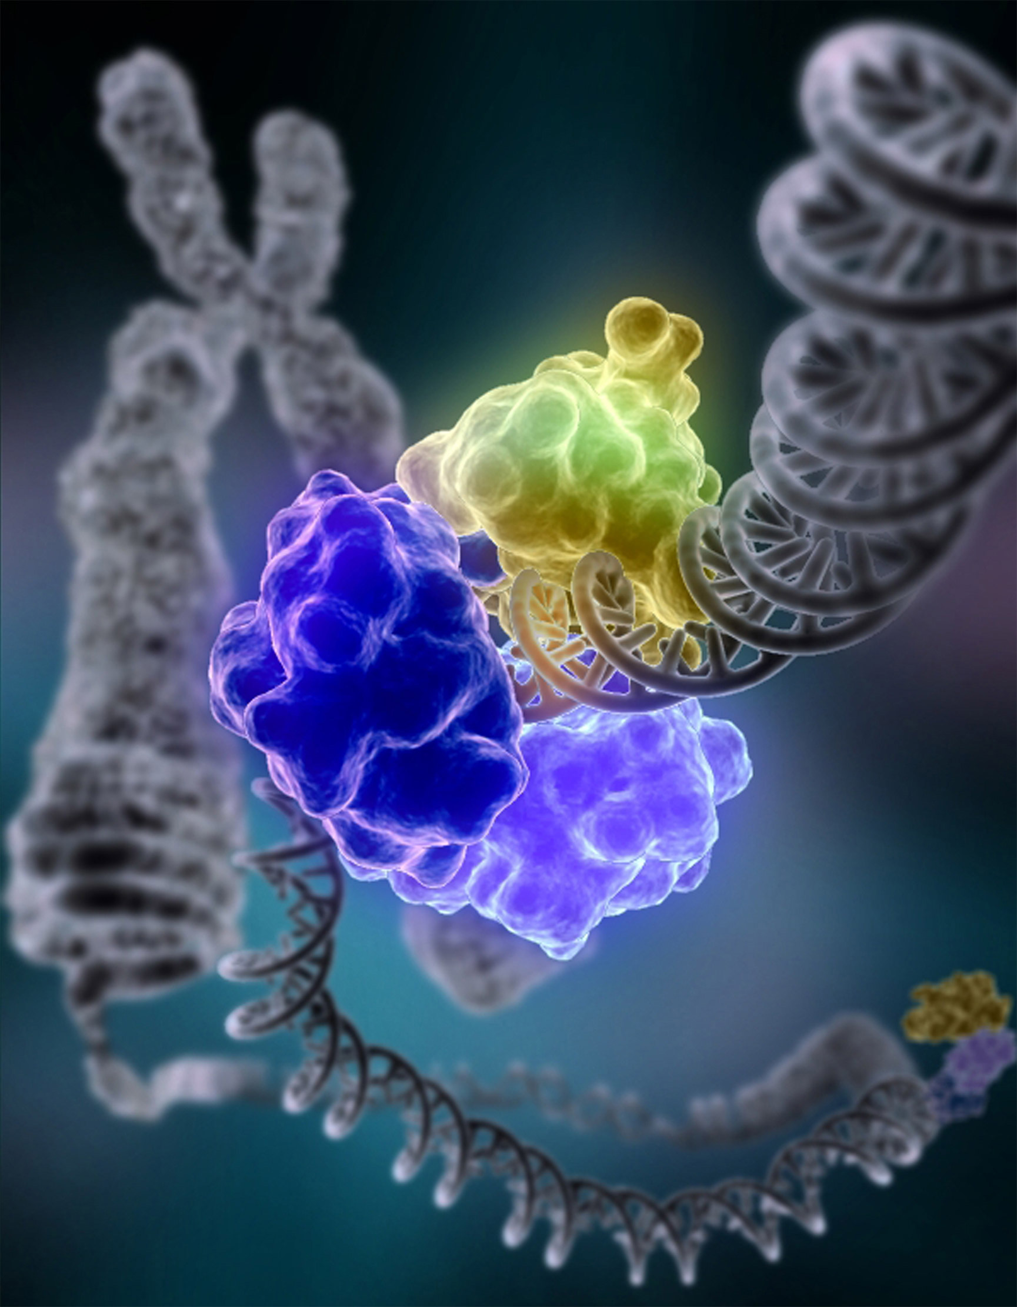
Topic 2: Enzyme Kinetics
Topic 2: Enzyme Kinetics

Slide 2
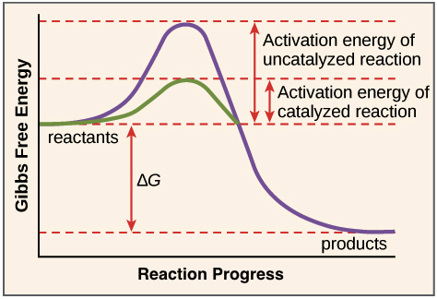
What is an Enzyme?
Enzymes: are biological molecules (proteins) that act as catalysts* and help complex reactions take place
Basically, they break a protein down into its amino acids, and speed up biological reactions by lowering the amount of activation energy required to run the reaction
*catalyst: a substance that causes or accelerates a chemical reaction without itself being affected.
Notes:
Please take some time to describe the figure in detail, the students may have many questions about what DeltaG is, so forth—but may not ask

Slide 3
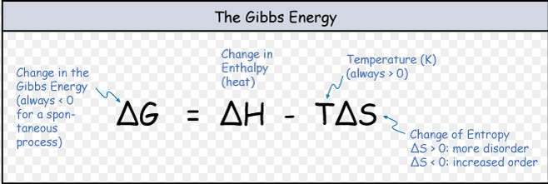
What’s Gibbs Free Energy from that graph in the last slide?
To determine the change in entropy, when a process occurs at constant temperature and pressure , we use the second law of thermodynamics to define Gibbs free energy:
The second law of thermodynamics: For the universe, the total entropy of isolated system increase over time, and changes in the entropy in the universe can never be negative.

Slide 4
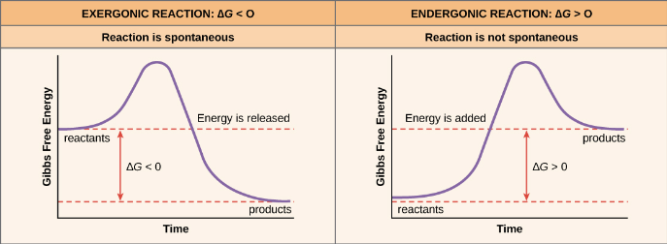
Endergonic and Exergonic Reactions
Reactions that have a negative ∆G release free energy and are exergonic or spontaneous reactions, since they occur without the addition of energy.
Reactions with a positive ∆G (∆G > 0), require energy to be put into the system and are thus endergonic, where the products, or final state, have more free energy than the reactants, or initial state.
Okay, but what do enzymes have to do with this?:
Enzymes decrease the Gibbs free energy of activation, and work by lowering the activation energy (ΔG✳) for a reaction.

Slide 5
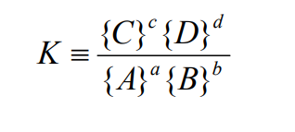
Using this concept to solve a chemical equilibrium
Consider a reversible reaction taking place at constant temperature. The reactants A and B combine to form products C and D:
The ratio of these concentrations (or activities – active concentrations) is characteristic for each reaction, and is called the equilibrium constant, K (Remember! At equilibrium, forward and reverse reactions are occurring at the same rate):

Slide 6
Chemical Equilibrium Continued
If we add more reactant or more product, the reaction will proceed spontaneously (without external help) as long as the value for Gr decreases
Thus, a reaction in the direction of decreasing Gr is spontaneous (G<0). A reaction in the direction of increasing Gr is not spontaneous and will not occur in a closed system. At equilibrium, G=0 and is not spontaneous.

Slide 7
CLASS BOARD PROBLEM

Slide 8
Step 1:Calculate the free energy at standard state (T= 25 C, P= 1 atm)

Slide 9
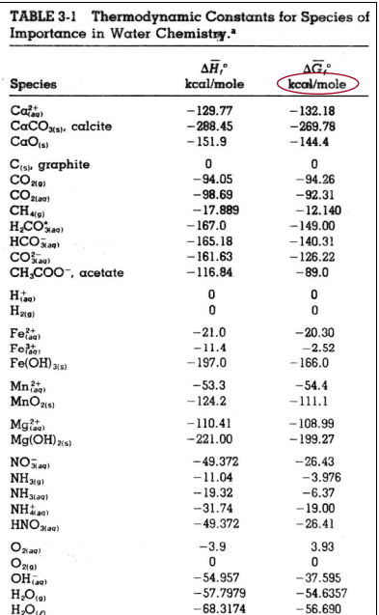

Slide 10
Step 2:Substitute in values and solve

Slide 11
Class tries On their own:

Slide 12
What answer did you get? Why?

Slide 13
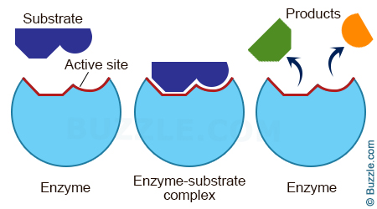
Properties of Enzymes
Any substance that blocks or changes the shape of the active site* will interfere with the activity and efficiency of the enzyme.
*Active Site : the part of the enzyme where substrate molecules bind and undergo a chemical reaction.
The active site consists of residues that form temporary bonds with the *substrate (binding site) and residues that catalyze a reaction of that substrate (catalytic site).
*Substrate: the substrate is a molecule upon which an enzyme acts

Slide 14
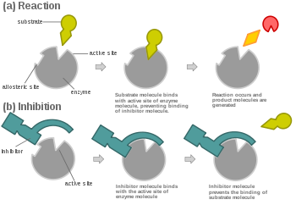
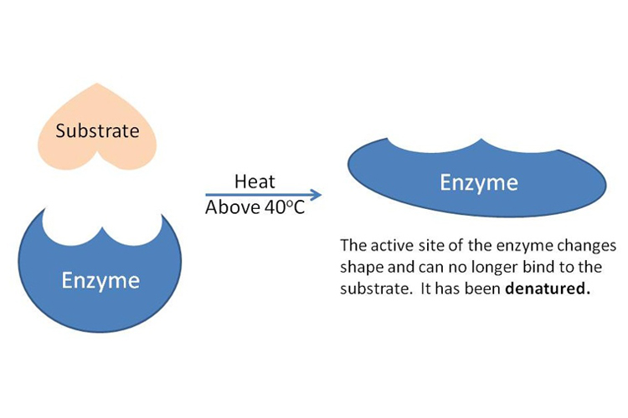
How are Enzymes Affected?
Inhibitors : are molecules that are similar in shape to the substrate. These molecules bind to and block the active site.
Denaturation : is the irreversible change in an enzyme's, or any protein's, three-dimensional structure, which leads to a loss of its catalytic abilities.
Important!: An enzyme's SHAPE is CRITICAL to its proper functioning
So?: the cell must maintain optimal conditions to preserve the enzyme's shape.

Slide 15
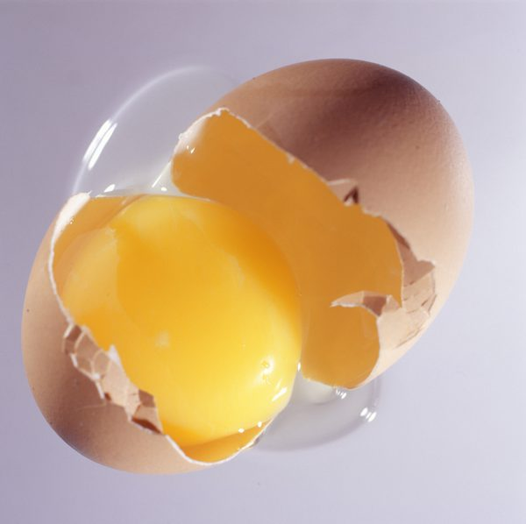
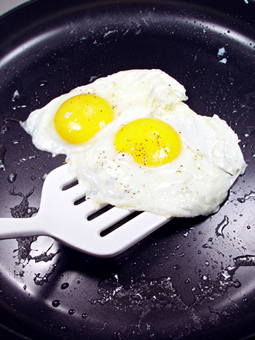
Class Question: Consider how you Cook an Egg, What do you think is happening? What is the catalyst? Is this a reversible reaction? Why?

Slide 16
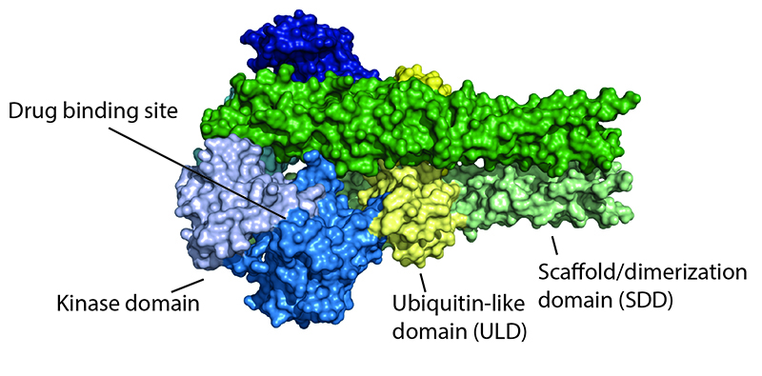
So what happens if the enzyme’s structure changes?
- If an enzyme's three-dimensional structure changes, the enzyme is unable to act as a catalyst.
- Enzymes function in different cells and in different organelles within cells….So?:
=> Enzymes are most efficient at different conditions. This has important consequences, especially when used for medical applications (see 3D enzyme structure diagram to right)
Conditions that affect enzyme shape and activity:
-salt concentration
-pH
-temperature

Slide 17
Overview: Enzymes exist as proteins, which have different levels of structure(1,2,3,4)
1.) Primary: the sequence of amino acids in a polypeptide chain ( peptide: a compound made of two or more amino acids linked in a chain, polypeptide refers to many peptides)
*Amino Acids: “The building blocks of life”: Make up proteins
=>Amino acids are simple organic compound containing both a carboxyl (—COOH) and an amino (—NH₂) group.
2.) Secondary: local folded structures that form within a polypeptide due to interactions between atoms of the backbone
3.) Tertiary: The overall three-dimensional structure of a polypeptide --The tertiary structure is primarily due to interactions between the R groups of the amino acids that make up the protein
4.) Quaternary: Some proteins are made up of multiple polypeptide chains, also known as subunits. When these subunits come together, they give the protein its quaternary structure

Slide 18
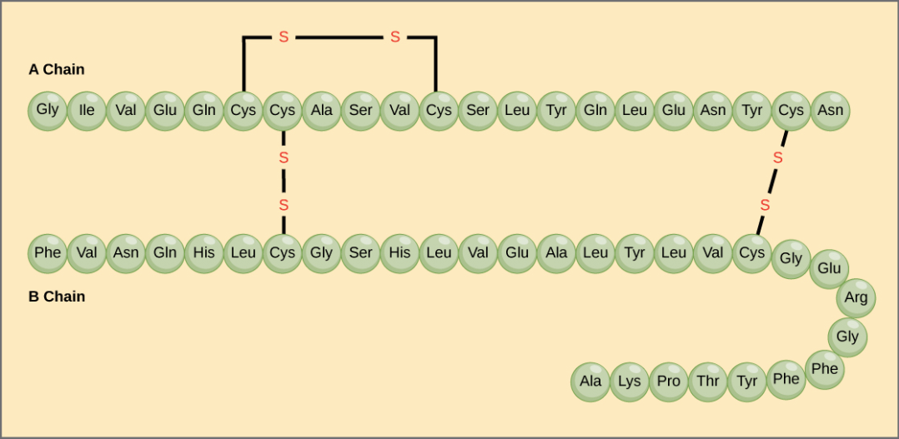
Primary Protein Structure
Going off what we talked about in the slide before, let’s consider the two polypeptide (meaning: many peptide) chains, A and B to the right for the hormone insulin
Each chain has its own set of amino acids, assembled in their own unique ways:
Notice the sequence of the A chain starts with Glycine at the N-terminus and ends with asparagine( Asn) an amino acid) at the C-terminus, and is different from the sequence of the B chain.
The sequence of a protein is determined by the DNA of the gene that encodes the protein
Fact!: Changing the DNA sequence of a gene can change in the amino acid sequence of the protein. One amino acid deviation can affect all the other structures and final shape of the protein!
C-terminus
N-terminus

Slide 19
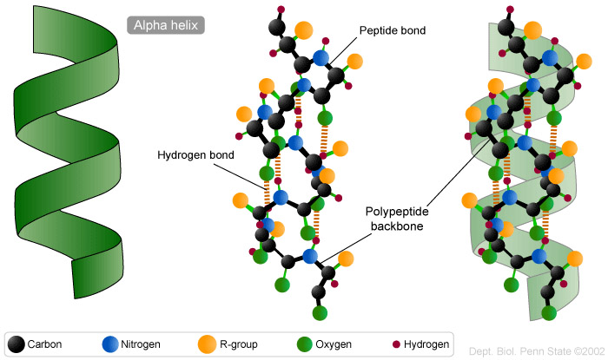
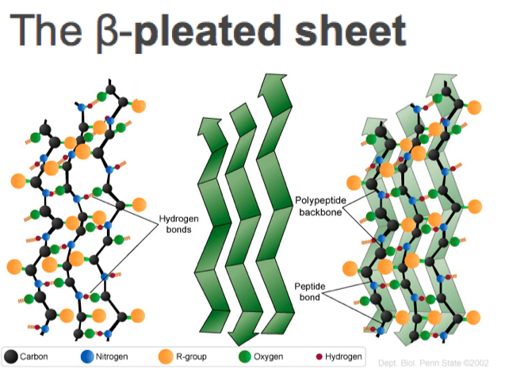
Secondary Protein Structure
Two types of secondary structures: α helix and the β pleated sheet.
Both held together by: *hydrogen bonds
*Hydrogen bonds form between the carbonyl O of one amino acid and the amino H of another
In an α helix: the carbonyl (C=O) of one amino acid is hydrogen bonded to the amino H (N-H) of an amino acid that is four down the chain.
This pattern of bonding pulls the polypeptide chain into a helical structure that resembles a curled ribbon
In a β pleated sheet: two or more parts of a polypeptide chain line up and form a sheet-like structure held together by hydrogen bonds.
The strands of a β pleated sheet may be parallel, pointing in the same direction or antiparallel, pointing in opposite directions

Slide 20
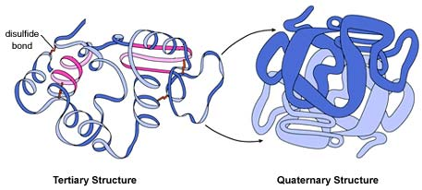
Tertiary Protein Structure
As discussed before, overall three-dimensional structure of a polypeptide is called its tertiary structure. The tertiary structure is primarily due to interactions between the R groups of the amino acids that make up the protein.
R group interactions : hydrogen bonding, ionic bonding, dipole-dipole interactions, and London dispersion forces
Important ! Hydrophobic interactions: amino acids with nonpolar, hydrophobic R groups cluster together on the inside of the protein, leaving hydrophilic amino acids on the outside to interact with surrounding water molecules.
Disulfide bonds: Covalent linkages between the sulfur-containing side chains of cysteines, are much stronger than the other types of bonds that contribute to tertiary structure
Disulfide bonds act like molecular "safety pins," keeping parts of the polypeptide firmly attached to one another.

Slide 21
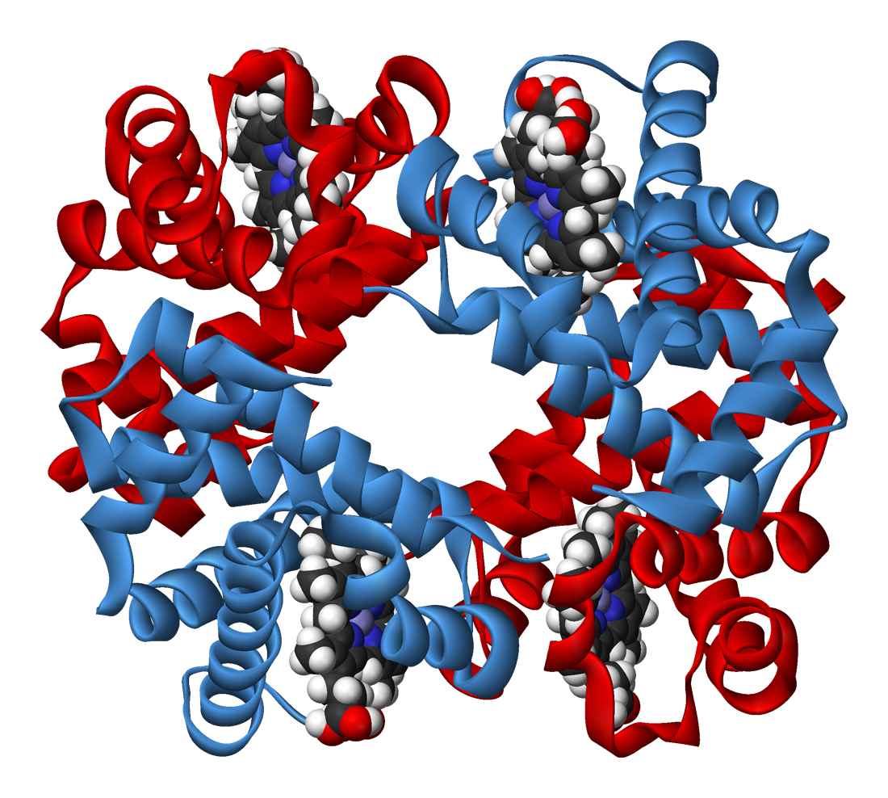
Quaternary Protein Structure
Example: Hemoglobin carries oxygen in the blood and is made up of four subunits, two each of the α and β types, it exists as a quaternary structure protein

Slide 22
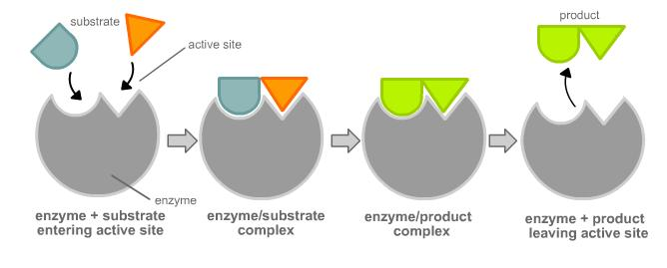
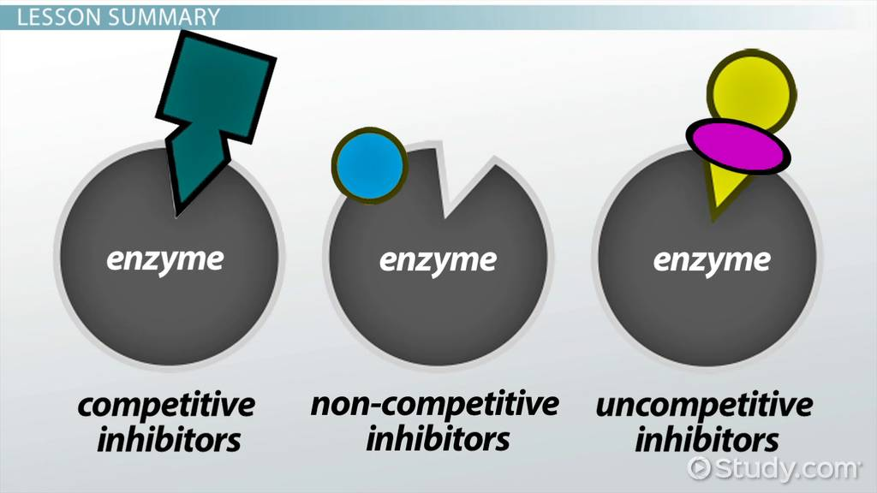
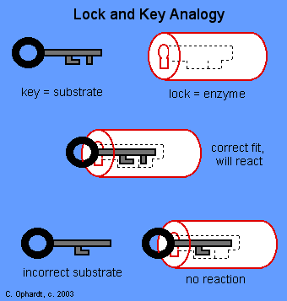
The Lock and Key Model: Binding Sites

Slide 23
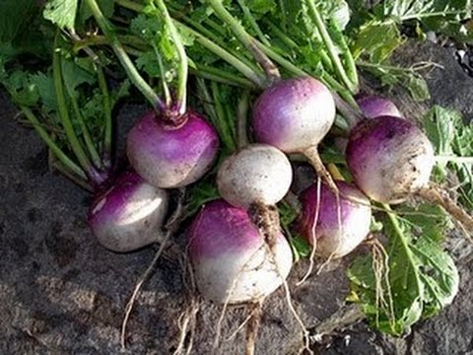
Example of an Enzyme: Peroxidase
The Enzyme peroxidase comes from turnips.
Peroxidases are found in plant and animal cells and function to convert toxic hydrogen peroxide (H₂O₂) into water and oxygen:
Then, oxygen produced from the breakdown of H2O2 reacts with organic compounds to form secondary cellular products:
So to conclude:

Slide 24
Enzyme Kinetics
Enzyme kinetics involves studying chemical reactions catalyzed by enzymes, in which the reactions rate is measured and the effects of varying the conditions of the reaction are investigated.
Enzyme kinetics can reveal the catalytic mechanism of this enzyme, metabolic roles, activity and function mediation, and how a drug, agonist or antagonist can affect the enzyme
As we talked about before, enzymes are typically proteins that interact with the substrate, by binding to active site and forming products via the mechanism below:

Slide 25
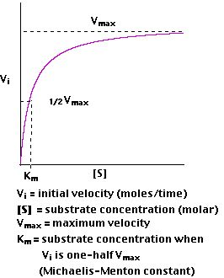
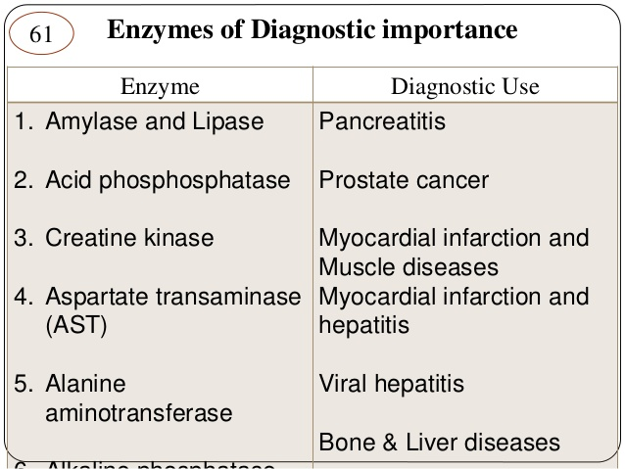
Enzyme Kinetics of Drugs: Calculating Rate of Product Formation
If:
Assuming:
Then:
Notes:
If you can, please use this information to show the class the derivation of the equation at the bottom

Slide 26
Pause here

